Slide 1
COMPANY LOGO
Employee Orientation to the
ISO 9001 Quality Management System
Rev. 0 – [Date of Issue]
(c) Copyright Year Company Name. All Rights Reserved.

Slide 2
What Is A Quality Management System?
Part One

Slide 3
Quality Management System (QMS)
Q
M
S
“Quality” means “meeting customer requirements.”
  Form, fit, function of hardware products
  Quality of services provided
  Prompt delivery
  Product/service Consistency
  Customer service
  Responsiveness to customer complaints

Slide 4
Quality Management System (QMS)
Q
M
S
“Quality Management” is the activities performed by the company to ensure those customer requirements are met.
  Inspections
  Measurements
  Customer feedback review
  Improvement activities

Slide 5
Quality Management System (QMS)
Q
M
S
“Quality Management System” is the set of processes a company utilizes to execute its quality management activities.
  The processes in the company that impact on quality
  Management of those processes through objectives and metrics
  Improving those processes to enhance quality and customer satisfaction

Slide 6
Quality Management System (QMS)
Every company has a quality system in place whether it knows it or not.
The QMS may be:
  Good or bad
  Formal or informal
  Documented or undocumented

Slide 7
Two Quality Systems
Joe’s Pizza
Amount of dough, cheese, etc.
Spices used
Oven temperature
Bake time
Boxes used
Delivery methods (pick up, deliver by car, etc.)
ABC Machine Shop
Make parts according to prints
Use raw materials from approved suppliers
Inspect parts before shipment
Repair defects found
Package properly
Ship all parts express

Slide 8
Standardizing Quality Systems
Because a company can have any kind of quality system it wants, customers do not know in advance whether the system is good or bad.
  Does a company inspect its work before delivery?
  Does a company have a way to handle complaints?
  Does a company use good raw materials?
  Are employees properly trained?

Slide 9

Enter ISO
The world recognized that this was a problem.
The International Organization for Standardization (ISO) intended to correct this, by standardizing quality systems.

Slide 10
What is ISO?
ISO is based in Geneva Switzerland.
Over 160 countries are members of ISO, including the US.
ISO develops all kinds of standards, such as traffic symbols, material standards, inspection practices, and more.

Slide 11
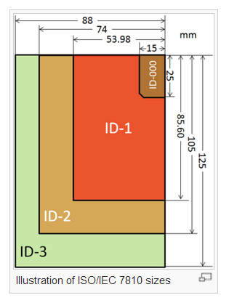
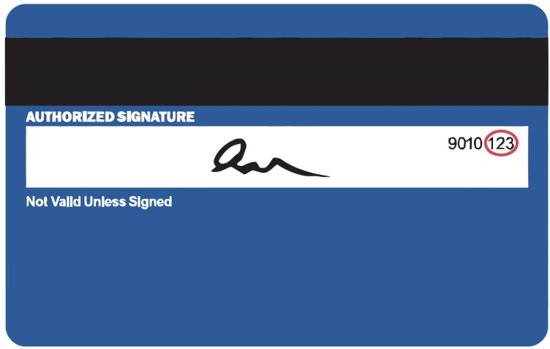
Example: an ISO Standard
ISO standardized credit card sizes
If credit cards didn’t comply with ISO 7810, they wouldn’t physically fit in bank machines
Source: Wikipedia

Slide 12
What is ISO 9001?
In 1987 ISO published “ISO 9001” a document (or standard) that lists some internationally-accepted, basic rules for a model quality system.
Remember:
  “ISO” is an organization
  “ISO 9001” is a document

Slide 13
ISO 9001 “Rules”
ISO 9001 does nothing more than just list some rules for managing a company’s quality system.
These rules have been recognized by the world as generally-accepted “good practices”

Slide 14
Adopting ISO 9001
Companies voluntarily adopt the ISO 9001 rules in order to prove that their systems are:
  GOOD
  Based on internationally-accepted criteria
  Meet minimum requirements for quality

Slide 15
Certification
Anyone can SAY they comply to ISO 9001. So “certification” was developed.
Certification (or “registration”) to ISO 9001 is accomplished through regular, recurring “audits” by an independent ISO registrar, who comes on-site and inspects the company’s compliance with the standards.

Slide 16
Our Intent
It is our company’s intent to implement the common sense rules of ISO 9001 and then certify it.
Our certification body (or “registrar”) is [your registrar’s company name].
The registrar will audit us periodically to ensure we are complying with ISO 9001.
Registrar Logo (if registrar is known)

Slide 17
Our Quality System
Part Two

Slide 18
What We Have Based our System On
Our quality system is unique.
It is based on:
  The company Quality Policy
  Customer requirements
  Employee requirements
  Other stakeholder requirements
  ISO 9001 requirements

Slide 19
Your Responsibilities
Everyone in the company has a responsibility to understand and improve the quality system. This means:
  Understand the Quality Policy
  Understand the Quality Manual (managers and supervisors)
  Understand the Procedures related to your area
  Make suggestions for improvement, or report existing problems

Slide 20
Documentation
Customize this whole slide to reflect actual practice
Quality System Documents
  Quality Manual
  Procedures
  Forms
Technical Documents
  Drawings
  Specifications
  MPPs

Slide 21
Where to Find Documents
Customize this whole slide to reflect actual practice
Our server
Specially marked binders in your area.
Document Department.
NOTE:
If you have documents that are not under revision control, please forward them to the management and we will place them on the server.
Contact management if you are unable to locate a document.

Slide 22
Quality Policy
ENTER QUALITY POLICY HERE

Slide 23
Understanding the Quality Policy
As an employee, you must be familiar with the Quality Policy as it defines how you should approach everything you do while working with our company.
PLUS, auditors will ask you what the Quality Policy is and how it affects your job.

Slide 24
Quality Manual
Derived from the Quality Policy is the Quality Manual.
Again, it not only addresses how we meet the requirements of the Quality Policy, but also those of ISO 9001.
INSERT GRAPHIC OF COVER OF QUALITY MANUAL HERE

Slide 25
Quality Manual
Customize this whole slide to reflect actual practice
The Quality Manual must be read by all managers and supervisors.
You must be sure to implement those requirements in your department or area.
All other employees may read it optionally.
Some of it will not apply to your position.

Slide 26
Procedures
Procedures must be read by affected employees.
That means you only need to read and understand the procedures that apply to your work.
These give more detailed descriptions of how to carry out tasks, operate equipment, etc.

Slide 27
Work Instructions
(If you have work instructions in addition to procedures, add a slide here discussing the work instructions in general, and how they are different from procedures.)
If you don’t use work instructions, delete this slide.

Slide 28
Controlled Documents
Manuals, procedures and forms are “controlled” to ensure you have the latest information.
Use only hardcopy procedures and manuals issued by management.
Or you may use electronics files pulled from the server files.
Do not photocopy controlled documents.
Do not mark up controlled documents.
Customize this whole slide to reflect actual practice

Slide 29
Do Not Use Uncontrolled Docs
Customize this whole slide to reflect actual practice
These are:
  Manuals, procedures, specs or instructions NOT issued by management.
  Documents you’ve written yourself and have not sent in for control.
  Documents from other companies.
  Documents without revision numbers or letters.
  Documents marked “OBSOLETE”
  Documents you know are obsolete.

Slide 30
Anything that INSTRUCTS
Any document that instructs – tells you what to do – must be controlled.
This means charts, logs, diagrams or any other document created for our company which tells an operator how to do something.

Slide 31
Forms
You may write on and photocopy forms.
Always be sure you are using the latest revision of a form by checking with your supervisor or with the management
Customize this whole slide to reflect actual practice

Slide 32

Correcting a Record
If you make a mistake when entering data on a hardcopy form, it is important not to use correction fluid (which eventually flakes off) .
The proper method is:

Slide 33
Correcting a Document
We don’t want employees blindly following procedures if they are wrong, or just bad.
If you find something wrong with a document, you can see that it gets fixed!
Submit a [CAR Form Abbreviation] when you find an error in a document.

Slide 34
Other Rules of the Quality System
Part Three

Slide 35
Management’s Job
ISO 9001 and our Quality System require top management:
  Care about quality
  Care about the customers
  Promote quality and the customer
  Assess risks and opportunities
  Supply necessary resources
  Measure and monitor the company’s performance

Slide 36
Training
All employees must be trained to bring them up to speed for position requirements
Training must also be done to continually improve how we do things

Slide 37
Understand the Customer’s Requirements
Contracts must “capture” and review all customer requirements.
This is to ensure we can actually make what the customer wants.
This must happen before we take an order.

Slide 38
Purchasing
Items we purchase for use in our products must be bought from proven suppliers.
We have to clearly tell the supplier what we want.
We have to monitor supplier performance.

Slide 39
Production Controls
When we make product, we must:
  Make sure we plan first
  Use approved equipment
  Use approved methods
  Preserve the product (good handling, packaging, etc.)
  Keep products properly identified
  NOT use expired chemicals or material

Slide 40
Calibration
Customize this whole slide to reflect actual practice
Tools used in inspection or testing must be calibrated.
Check your tool for a sticker.
If it’s not up to date, NOTIFY QC IMMEDIATELY.

Slide 41
Shop Router Rules
Customize this whole slide to reflect actual practice
ALL lines to be signed off or marked “N/A”
Performing operations out of sequence is okay with verbal approval from manager or supervisor
NO OTHER CHANGES TO ROUTERS ALLOWED WITHOUT TALKING TO QUALITY OR ENGINEERING!
No white out!

Slide 42
Nonconforming Parts
Whenever a part fails an inspection or test, it does not conform to requirements, so it is called a “nonconforming part.”
NCP can be:
  Raw materials or parts we receive from suppliers
  Parts or products we are in the process of making for our customers.
  Finished product ready for shipment to our customer.

Slide 43
Controlling NCP
Customize this whole slide to reflect actual practice
ISO requires that we identify defective material or parts and prevent it from being mistaken for good material or parts.
Keep it tagged!
Keep it segregated!
If applicable, keep any nonconformance documentation and/or tags ON THE PART(s)

Slide 44
Things to Consider
How does the quality of my work affect the customer?
How does the quality of my work affect us as a company?
If I do something wrong, how does this affect the customer?

Slide 45
Quality Audits
Part Four

Slide 46
What is Auditing?
As part of ISO 9001 and our Quality System, we have committed our company to both internal and external quality audits.
These are not financial audits, or audits by immigration or any other body.
These audits aim to ensure our ongoing compliance with ISO 9001, and to drive internal improvement.

Slide 47
External Audits
As we discussed, we intend to prove to the world it is complying with ISO 9001 through independent audits by a third-party “registrar”.
The Registrar will visit us periodically and compare:
  What we do vs. internal procedures
  What we do vs. ISO 9001

Slide 48
Ongoing External Auditing
We must pass each audit to maintain ISO 9001 certification.
The auditor may speak with anyone in the company. This may mean you!

Slide 49
Typical Audit Questions
What are you doing?
How do you do that?
Do you have a procedure?
Have you been trained?
What do you do when something goes wrong?
What is the Quality Policy?

Slide 50
Internal Audits
We also have to conduct “internal audits” to ensure we are sticking to our Quality Manual policies and the ISO 9001 requirements.
Some of you will be selected and trained as internal auditors.

Slide 51
Auditing Processes, Not People
Audits are conducted to confirm PROCESS adequacy.
People are not the focus of audits!
“YOU” are not audited,
the PROCESS is!

Slide 52
Corrective & Preventive Action
Part Five

Slide 53
Continual Improvement
One of the requirements of ISO 9001 is that the company must continually improve.
In order to do this, we have implemented the [CAR Form Abbreviation] program.
Supervisors and Managers must become familiar with this!

Slide 54
What is a [CAR Form Abbreviation]?
A [CAR Form Abbreviation] is a form submitted whenever we have to report:
  A report of a problem
  A customer complaint
  A customer return
If you find a problem, notify your supervisor, who will initiate a [CAR Form Abbreviation], as needed.

Slide 55
[CAR Form Abbreviation] Form
This is the [CAR Form Abbreviation] form
Copies are available in QC, the Document Dept. and other locations around the plant
INSERT GRAPHIC CAR FORM

Slide 56
Corrective vs. Preventive
The form is used to report EXISTING problems, or things that require a change in order to prevent recurrence.
It is also used for preventive action, to report potential problems, or to prevent occurrence.
It is also used for any employee suggestion for improvement.

Slide 57
The Only Rule
The only rule for submitting a one of these is that the issue you are reporting be somehow quality related.
  Do not “write up” people
  Do not “grind axes”
  Make a quality case for your issue!

Slide 58
Conclusion
Part Six

Slide 59
Things to Remember
  Understand the Quality Policy
  Understand the Quality Manual (managers and supervisors)
  Understand the procedures related to your area
  Sweep your area for uncontrolled documents!
Customize this whole slide to reflect actual practice

Slide 60
Things to Remember
  Make suggestions for improvement and report existing problems through the corrective action system
  Get ready for an audit!

Slide 61
Questions?

